Slide 1

Biometric Breakthrough: AI‑Driven Blood Group Detection via Fingerprints
Non‑invasive blood typing: combining fingerprint imaging, advanced signal processing, and deep learning to predict ABO and Rh groups instantly at the point of care.

Slide 2




The Biological Foundation: Why Fingerprints?
Developmental Origin
Ridge patterns form by 7 months gestation and reflect micro‑environmental influences, producing stable, lifelong structure.
Microstructure Signals
Fine-scale skin features (pores, ridge width, sweat duct openings) may carry biochemical traces correlated with systemic markers.
Diagnostic Potential
Finger skin is vascularized and interacts with interstitial fluids—opening the possibility of non‑blood invasive biomarkers detectable visually or spectrally.

Slide 3
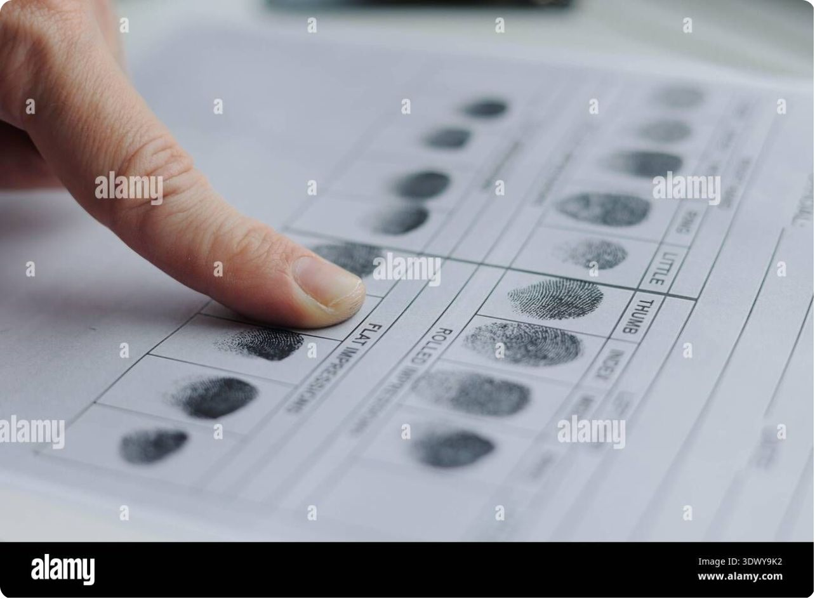
Traditional Sensing: From Ink to Silicon
Fingerprint capture has evolved through distinct generations:
Ink & paper: archival but low resolution and dirty
Optical sensors: high‑resolution images, sensitive to moisture and debris
Capacitive sensors: compact, reliable for minutiae detection
Ultrasound & multispectral: penetrates surface noise for sub‑surface features
Emerging touchless and sweep sensors reduce contamination and improve repeatability—critical for diagnostic extraction.

Slide 4
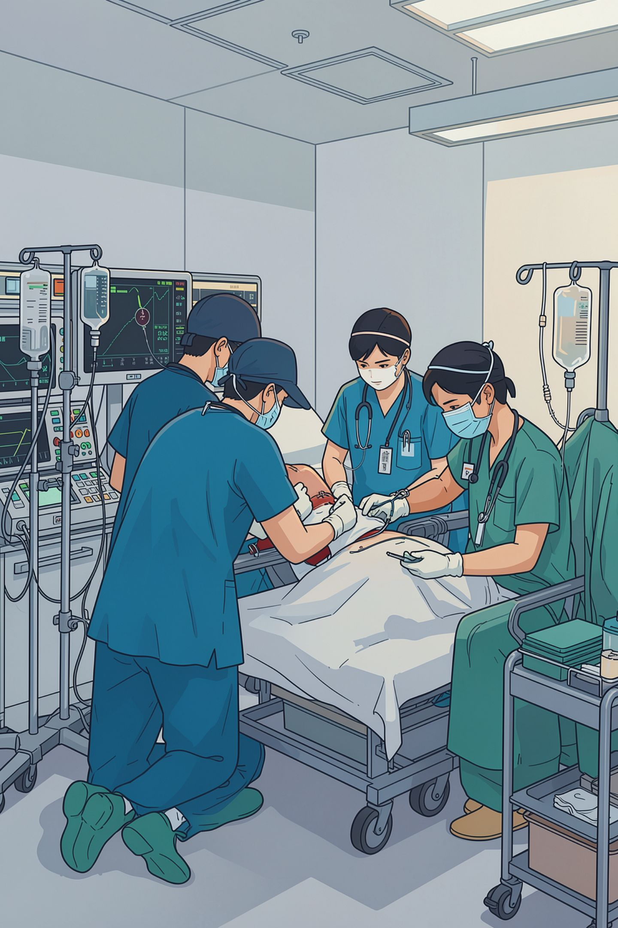
The Diagnostic Gap: Why Blood Group Matters
Critical Needs
Current Limitations
Opportunity
Rapid blood group info saves lives in trauma, transfusion, and surgery where minutes matter.
A portable, non‑invasive approach reduces time‑to‑treatment and expands care to low‑resource settings.
Standard serology is invasive, requires lab infrastructure, and introduces delays.

Slide 5

The AI Revolution: Bridging Biometrics and Hematology
Machine learning uncovers subtle correlations beyond human perception. By mapping high‑dimensional fingerprint features to antigenic profiles, AI transforms fingerprints from identity tokens into diagnostic sensors.
Supervised classification on labeled fingerprint–bloodgroup pairs
Feature fusion: combining texture, pore distribution, and spectral cues
Explainability: saliency maps to highlight predictive regions on the print

Slide 6
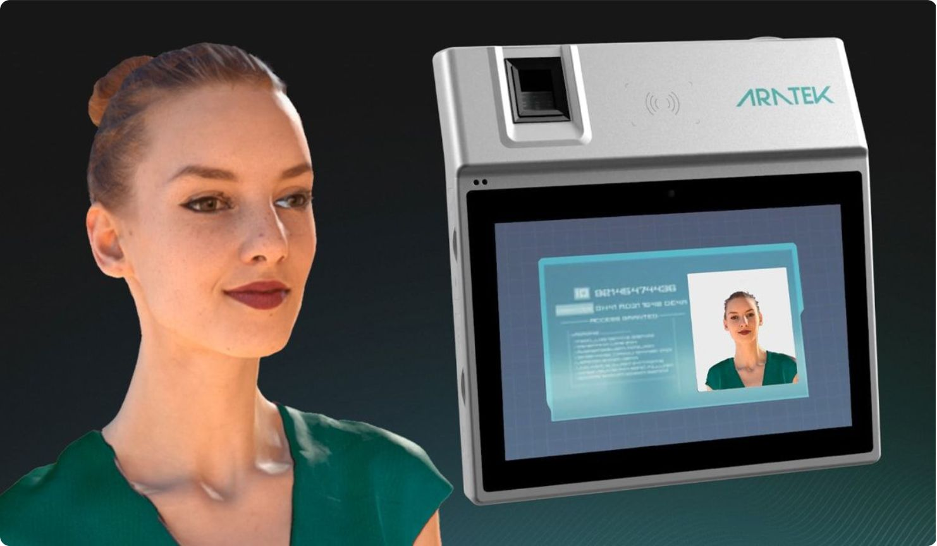
Technical Architecture: How the System Works
01
1. Acquisition
High‑resolution optical/capacitive capture, optional multispectral imaging to reveal sub-surface info.
02
2. Pre‑processing
Registration, mosaicking for large-area scans, normalization, and denoising to stabilize inputs.
03
3. Feature Extraction
Global ridge-flow, minutiae sets, pore distribution, and texture descriptors; optional spectral channel features.
04
4. Classification & Output
Ensemble deep models produce blood group probabilities with confidence intervals and uncertainty flags.

Slide 7


The AI Engine: Pattern Recognition and Classification
Model strategies to improve robustness and reliability:
Convolutional backbones with multi‑branch heads for texture and minutiae
Synthetic augmentation: pressure, rotation, skin condition, lighting variance
Uncertainty estimation: Bayesian layers and calibrated probabilities to flag low‑confidence reads
Key: prioritize model interpretability and rigorous validation against serology before clinical use.

Slide 8
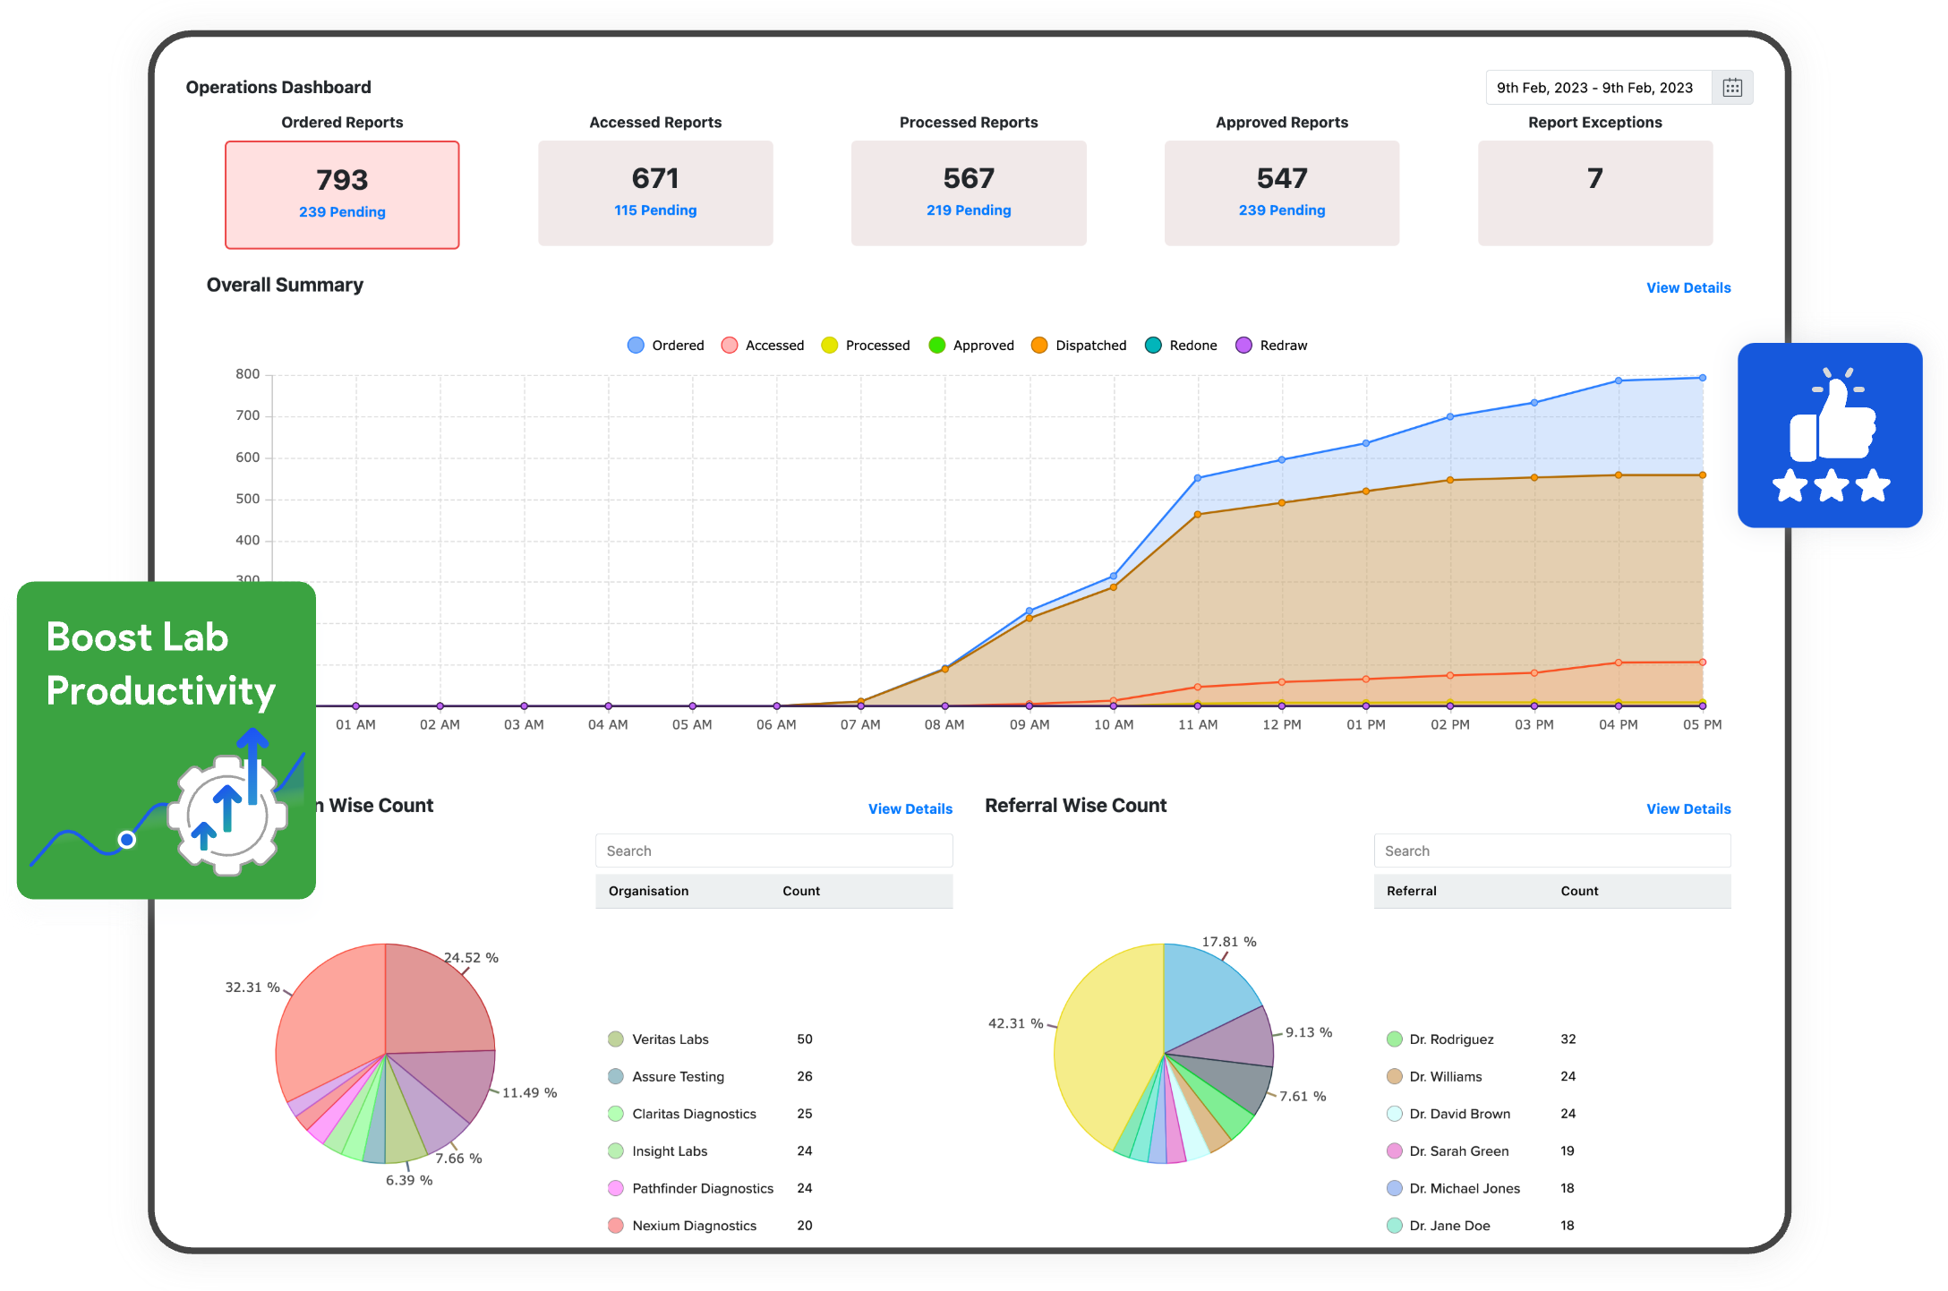
Performance and Reliability
Evaluation must mirror clinical standards:
Benchmark against gold‑standard serology with blinded trials
Report sensitivity, specificity, positive predictive value, and confidence intervals
Mitigate failure modes: poor scans, skin contaminants, and device drift
Security & ethics:
Anti‑spoofing (liveness checks) and secure on‑device models to protect privacy
Consent, data minimization, and transparent reporting of limits

Slide 9

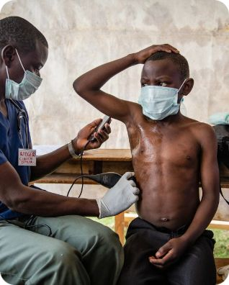

Real‑World Impact: The Future of Point‑of‑Care
Emergency Response
Low‑Resource Settings
Disaster & Public Health
Instant blood type at the scene shortens time to transfusion and improves triage decisions.
Reduced lab dependence lowers costs and expands access to safe transfusion practices.
Scalable deployments in mass‑casualty or epidemic scenarios improve rapid decision making.

Slide 10
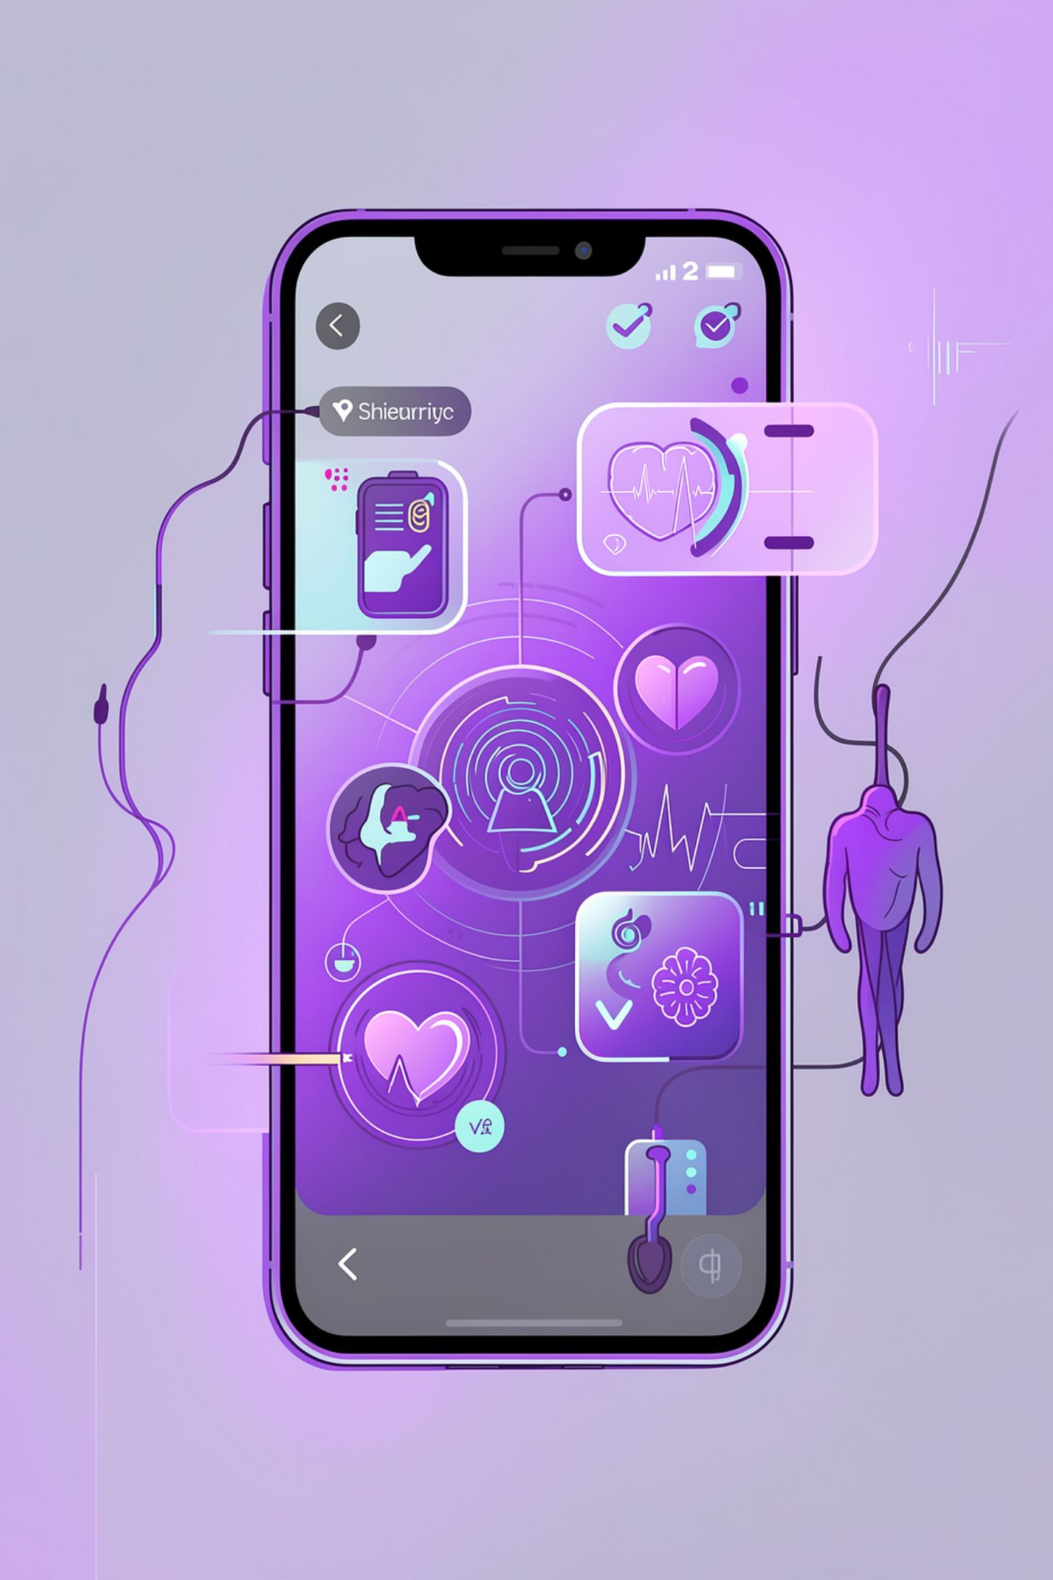



The Next Era: Seamless Diagnostic Integration
Roadmap highlights and call to action:
1
2
3
1. Clinical Validation
2. Regulatory Pathways
3. Productization
Large multicenter trials to quantify accuracy across populations and skin types.
Integrate touchless 3D scanners, on‑device AI, and privacy‑first data handling for broad adoption.
Engage with regulators early to define evidence and post‑market surveillance requirements.
4
4. Partnership & Investment
Collaborate with hospitals, NGOs, and device manufacturers to scale deployments responsibly.
Call to Action: Fund rigorous validation and responsible deployment to unlock safe, non‑invasive blood typing at scale.

